Slide 1
Force Field Transformation
Ganiyu Ibraheem & Philipp Seybold
Advanced Computer Vision

Slide 2
Overview
Definition
Method Application
Demonstration
Results
Discussion

Slide 3
Definition
Objective:
Reduce dimensionality of pattern space
Maintain discriminator power
By: David J. Hurley, Mark S. Nixon & John N. Carter
Domain: Ear & face recognition
Notes:
Objective:
reduce dimensionality of pattern space
yet maintain discriminator power for classification and invariant description
Used/invented by … for ear biometric

Slide 4
Method
Idea: Treat every pixel as a force exerting particle
Steps:
Image to force field transformation
Potential well and channel extraction
Approaches:
Pixel by pixel
Frequency domain analysis
Notes:
Approaches:
Brute Force: Each pixel is transformed using the Energy & Force equations
Frequency Domain Analysis: Fourier Transform etc. and then equations applied

Slide 5
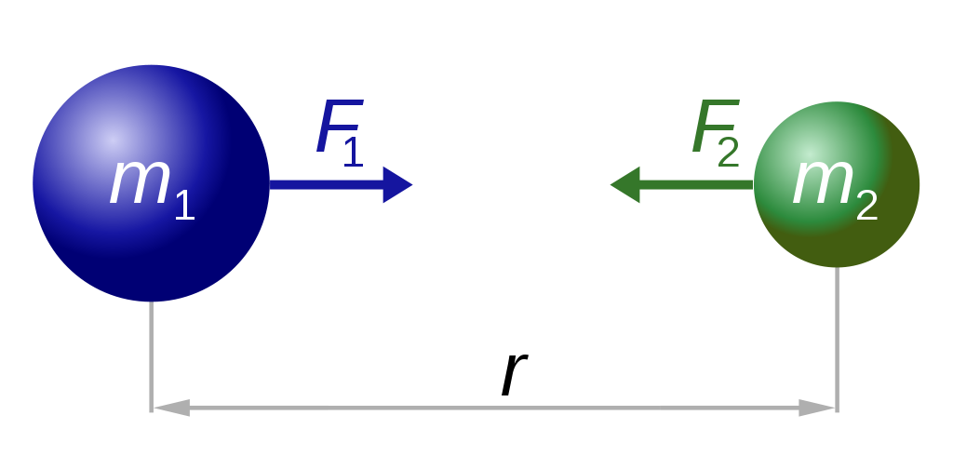
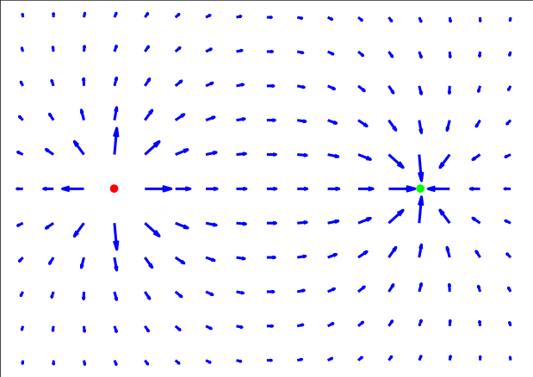

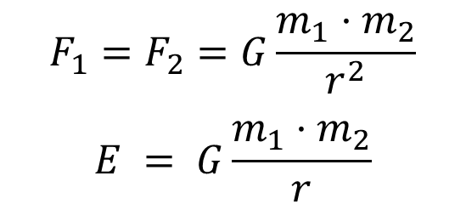
Method
Assumption: Each pixel $r_{i}$ exerts an isotropic force proportional to its intensity (brightness) $P(r_{i})$
$$F_{1}=F_{2}=G\frac{m_{1}⋅m_{2}}{r^{2}}$$
$$E = G\frac{m_{1}⋅m_{2}}{r}$$
Force field vectors of an electric field
Newton's law of gravitation
Images source: wikipedia.org
Notes:
Assumption: (for mathematical convenience): Each pixel exerts an isotropic force on all the other pixels (they represent attractive particles, that act as the source of a spherically symmetric force field) that is proportional to pixel intensity and inversely proportional to the square of the distance, i.e. the inverse square law

Slide 6
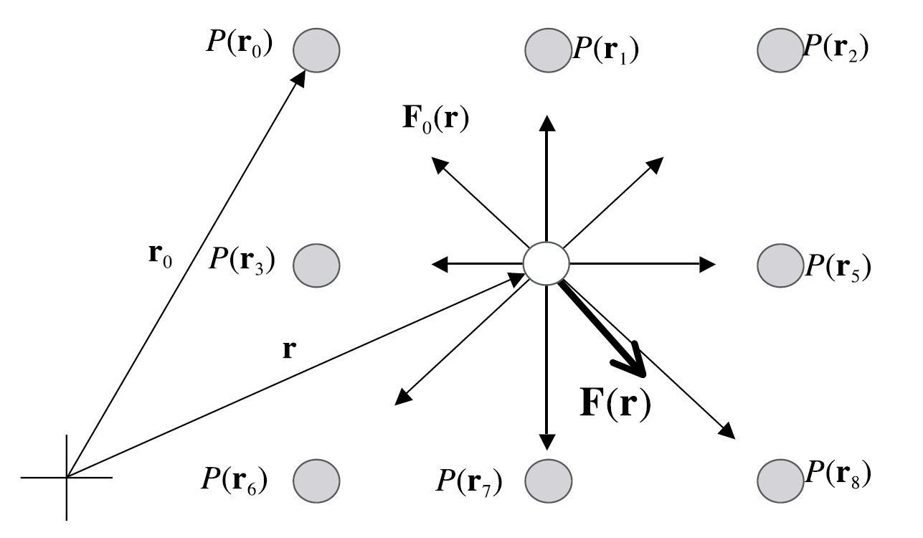

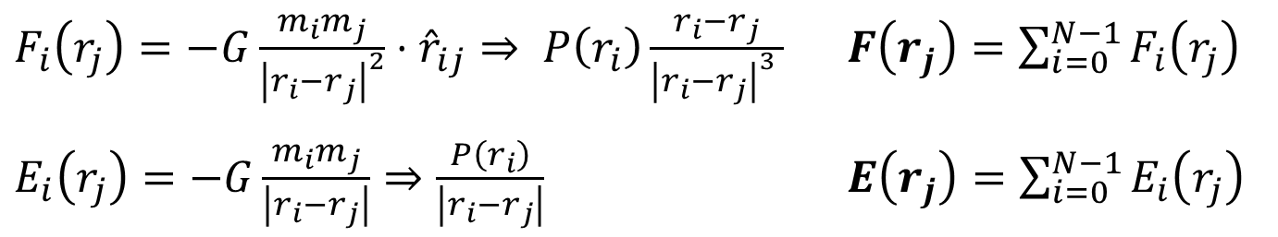


Method
$${}_{j}$$
$$r_{j}$$
$${}_{j}$$
$${}_{j}$$
Image source: [1]
$F_{i}\left(r_{j}\right)=−G\frac{m_{i}m_{j}}{{\left|r_{i}−r_{j}\right|}^{2}}⋅{\hat{r}}_{ij}⇒ P\left(r_{i}\right)\frac{r_{i}−r_{j}}{{\left|r_{i}−r_{j}\right|}^{3} }$ $F\left(r_{j}\right)=\sum_{i=0}^{N−1}{F_{i}\left(r_{j}\right)}$
$E_{i}\left(r_{j}\right)=−G\frac{m_{i}m_{j}}{\left|r_{i}−r_{j}\right|}⇒\frac{P\left(r_{i}\right)}{\left|r_{i}−r_{j}\right|}$ $E\left(r_{j}\right)=\sum_{i=0}^{N−1}{E_{i}\left(r_{j}\right)}$
Notes:
The definition for force field vectors in the gravity domain: $F_{i}\left(r_{j}\right)=−G\frac{m_{i}m_{j}}{{\left|r_{i}−r_{j}\right|}^{2}}⋅{\hat{r}}_{ij}$, where ${\hat{r}}_{ij}$ is the unit vector
$F_{i}\left(r_{j}\right)$ is the force field vector of a pixel position vector $r_{j}$ that another vector $r_{i}$ exerts on it.
The sum over all these force vectors, where the pixel intensities $P\left(r_{i}\right)$ are unified, gives the force field vector $F\left(r_{j}\right)$ for that position $r_{j}$
Same for the potential Energy field that is associated with the force field generated by each pixel,
with $E_{i}\left(r_{j}\right)$ being the potential energy that its imparted to a pixel of unit intensity at the pixel location r_j by the energy field of any other pixel with position vector r_i and pixel intensity P(r_i)

Slide 7
Method
$${}_{j}$$
$$r_{j}$$
$${}_{j}$$
$${}_{j}$$
Image source: [1]
$F_{i}\left(r_{j}\right)=−G\frac{m_{i}m_{j}}{{\left|r_{i}−r_{j}\right|}^{2}}⋅{\hat{r}}_{ij}⇒ P\left(r_{i}\right)\frac{r_{i}−r_{j}}{{\left|r_{i}−r_{j}\right|}^{3} }$ $F\left(r_{j}\right)=\sum_{i=0}^{N−1}{F_{i}\left(r_{j}\right)}$
$E_{i}\left(r_{j}\right)=−G\frac{m_{i}m_{j}}{\left|r_{i}−r_{j}\right|}⇒\frac{P\left(r_{i}\right)}{\left|r_{i}−r_{j}\right|}$ $E\left(r_{j}\right)=\sum_{i=0}^{N−1}{E_{i}\left(r_{j}\right)}$
Notes:
The definition for force field vectors in the gravity domain: $F_{i}\left(r_{j}\right)=−G\frac{m_{i}m_{j}}{{\left|r_{i}−r_{j}\right|}^{2}}⋅{\hat{r}}_{ij}$, where ${\hat{r}}_{ij}$ is the unit vector
$F_{i}\left(r_{j}\right)$ is the force field vector of a pixel position vector $r_{j}$ that another vector $r_{i}$ exerts on it.
The sum over all these force vectors, where the pixel intensities $P\left(r_{i}\right)$ are unified, gives the force field vector $F\left(r_{j}\right)$ for that position $r_{j}$
Same for the potential Energy field that is associated with the force field generated by each pixel,
with $E_{i}\left(r_{j}\right)$ being the potential energy that its imparted to a pixel of unit intensity at the pixel location r_j by the energy field of any other pixel with position vector r_i and pixel intensity P(r_i)

Slide 8
Method
$${}_{j}$$
$$r_{j}$$
$${}_{j}$$
$${}_{j}$$
Image source: [1]
$F_{i}\left(r_{j}\right)=−G\frac{m_{i}m_{j}}{{\left|r_{i}−r_{j}\right|}^{2}}⋅{\hat{r}}_{ij}⇒ P\left(r_{i}\right)\frac{r_{i}−r_{j}}{{\left|r_{i}−r_{j}\right|}^{3} }$ $F\left(r_{j}\right)=\sum_{i=0}^{N−1}{F_{i}\left(r_{j}\right)}$
$E_{i}\left(r_{j}\right)=−G\frac{m_{i}m_{j}}{\left|r_{i}−r_{j}\right|}⇒\frac{P\left(r_{i}\right)}{\left|r_{i}−r_{j}\right|}$ $E\left(r_{j}\right)=\sum_{i=0}^{N−1}{E_{i}\left(r_{j}\right)}$
Notes:
The definition for force field vectors in the gravity domain: $F_{i}\left(r_{j}\right)=−G\frac{m_{i}m_{j}}{{\left|r_{i}−r_{j}\right|}^{2}}⋅{\hat{r}}_{ij}$, where ${\hat{r}}_{ij}$ is the unit vector
$F_{i}\left(r_{j}\right)$ is the force field vector of a pixel position vector $r_{j}$ that another vector $r_{i}$ exerts on it.
The sum over all these force vectors, where the pixel intensities $P\left(r_{i}\right)$ are unified, gives the force field vector $F\left(r_{j}\right)$ for that position $r_{j}$
Same for the potential Energy field that is associated with the force field generated by each pixel,
with $E_{i}\left(r_{j}\right)$ being the potential energy that its imparted to a pixel of unit intensity at the pixel location r_j by the energy field of any other pixel with position vector r_i and pixel intensity P(r_i)

Slide 9
Method
$${}_{j}$$
$$r_{j}$$
$${}_{j}$$
$${}_{j}$$
Image source: [1]
$F_{i}\left(r_{j}\right)=−G\frac{m_{i}m_{j}}{{\left|r_{i}−r_{j}\right|}^{2}}⋅{\hat{r}}_{ij}⇒ P\left(r_{i}\right)\frac{r_{i}−r_{j}}{{\left|r_{i}−r_{j}\right|}^{3} }$ $F\left(r_{j}\right)=\sum_{i=0}^{N−1}{F_{i}\left(r_{j}\right)}$
$E_{i}\left(r_{j}\right)=−G\frac{m_{i}m_{j}}{\left|r_{i}−r_{j}\right|}⇒\frac{P\left(r_{i}\right)}{\left|r_{i}−r_{j}\right|}$ $E\left(r_{j}\right)=\sum_{i=0}^{N−1}{E_{i}\left(r_{j}\right)}$
Notes:
The definition for force field vectors in the gravity domain: $F_{i}\left(r_{j}\right)=−G\frac{m_{i}m_{j}}{{\left|r_{i}−r_{j}\right|}^{2}}⋅{\hat{r}}_{ij}$, where ${\hat{r}}_{ij}$ is the unit vector
$F_{i}\left(r_{j}\right)$ is the force field vector of a pixel position vector $r_{j}$ that another vector $r_{i}$ exerts on it.
The sum over all these force vectors, where the pixel intensities $P\left(r_{i}\right)$ are unified, gives the force field vector $F\left(r_{j}\right)$ for that position $r_{j}$
Same for the potential Energy field that is associated with the force field generated by each pixel,
with $E_{i}\left(r_{j}\right)$ being the potential energy that its imparted to a pixel of unit intensity at the pixel location r_j by the energy field of any other pixel with position vector r_i and pixel intensity P(r_i)

Slide 10
Method
$${}_{j}$$
$$r_{j}$$
$${}_{j}$$
$${}_{j}$$
Image source: [1]
$F_{i}\left(r_{j}\right)=−G\frac{m_{i}m_{j}}{{\left|r_{i}−r_{j}\right|}^{2}}⋅{\hat{r}}_{ij}⇒ P\left(r_{i}\right)\frac{r_{i}−r_{j}}{{\left|r_{i}−r_{j}\right|}^{3} }$ $F\left(r_{j}\right)=\sum_{i=0}^{N−1}{F_{i}\left(r_{j}\right)}$
$E_{i}\left(r_{j}\right)=−G\frac{m_{i}m_{j}}{\left|r_{i}−r_{j}\right|}⇒\frac{P\left(r_{i}\right)}{\left|r_{i}−r_{j}\right|}$ $E\left(r_{j}\right)=\sum_{i=0}^{N−1}{E_{i}\left(r_{j}\right)}$
Notes:
The definition for force field vectors in the gravity domain: $F_{i}\left(r_{j}\right)=−G\frac{m_{i}m_{j}}{{\left|r_{i}−r_{j}\right|}^{2}}⋅{\hat{r}}_{ij}$, where ${\hat{r}}_{ij}$ is the unit vector
$F_{i}\left(r_{j}\right)$ is the force field vector of a pixel position vector $r_{j}$ that another vector $r_{i}$ exerts on it.
The sum over all these force vectors, where the pixel intensities $P\left(r_{i}\right)$ are unified, gives the force field vector $F\left(r_{j}\right)$ for that position $r_{j}$
Same for the potential Energy field that is associated with the force field generated by each pixel,
with $E_{i}\left(r_{j}\right)$ being the potential energy that its imparted to a pixel of unit intensity at the pixel location r_j by the energy field of any other pixel with position vector r_i and pixel intensity P(r_i)

Slide 11
Method
$${}_{j}$$
$$r_{j}$$
$${}_{j}$$
$${}_{j}$$
Image source: [1]
$F_{i}\left(r_{j}\right)=−G\frac{m_{i}m_{j}}{{\left|r_{i}−r_{j}\right|}^{2}}⋅{\hat{r}}_{ij}⇒ P\left(r_{i}\right)\frac{r_{i}−r_{j}}{{\left|r_{i}−r_{j}\right|}^{3} }$ $F\left(r_{j}\right)=\sum_{i=0}^{N−1}{F_{i}\left(r_{j}\right)}$
$E_{i}\left(r_{j}\right)=−G\frac{m_{i}m_{j}}{\left|r_{i}−r_{j}\right|}⇒\frac{P\left(r_{i}\right)}{\left|r_{i}−r_{j}\right|}$ $E\left(r_{j}\right)=\sum_{i=0}^{N−1}{E_{i}\left(r_{j}\right)}$
Notes:
The definition for force field vectors in the gravity domain: $F_{i}\left(r_{j}\right)=−G\frac{m_{i}m_{j}}{{\left|r_{i}−r_{j}\right|}^{2}}⋅{\hat{r}}_{ij}$, where ${\hat{r}}_{ij}$ is the unit vector
$F_{i}\left(r_{j}\right)$ is the force field vector of a pixel position vector $r_{j}$ that another vector $r_{i}$ exerts on it.
The sum over all these force vectors, where the pixel intensities $P\left(r_{i}\right)$ are unified, gives the force field vector $F\left(r_{j}\right)$ for that position $r_{j}$
Same for the potential Energy field that is associated with the force field generated by each pixel,
with $E_{i}\left(r_{j}\right)$ being the potential energy that its imparted to a pixel of unit intensity at the pixel location r_j by the energy field of any other pixel with position vector r_i and pixel intensity P(r_i)

Slide 12
Method
$${}_{j}$$
$$r_{j}$$
$${}_{j}$$
$${}_{j}$$
Image source: [1]
$F_{i}\left(r_{j}\right)=−G\frac{m_{i}m_{j}}{{\left|r_{i}−r_{j}\right|}^{2}}⋅{\hat{r}}_{ij}⇒ P\left(r_{i}\right)\frac{r_{i}−r_{j}}{{\left|r_{i}−r_{j}\right|}^{3} }$ $F\left(r_{j}\right)=\sum_{i=0}^{N−1}{F_{i}\left(r_{j}\right)}$
$E_{i}\left(r_{j}\right)=−G\frac{m_{i}m_{j}}{\left|r_{i}−r_{j}\right|}⇒\frac{P\left(r_{i}\right)}{\left|r_{i}−r_{j}\right|}$ $E\left(r_{j}\right)=\sum_{i=0}^{N−1}{E_{i}\left(r_{j}\right)}$
Notes:
The definition for force field vectors in the gravity domain: $F_{i}\left(r_{j}\right)=−G\frac{m_{i}m_{j}}{{\left|r_{i}−r_{j}\right|}^{2}}⋅{\hat{r}}_{ij}$, where ${\hat{r}}_{ij}$ is the unit vector
$F_{i}\left(r_{j}\right)$ is the force field vector of a pixel position vector $r_{j}$ that another vector $r_{i}$ exerts on it.
The sum over all these force vectors, where the pixel intensities $P\left(r_{i}\right)$ are unified, gives the force field vector $F\left(r_{j}\right)$ for that position $r_{j}$
Same for the potential Energy field that is associated with the force field generated by each pixel,
with $E_{i}\left(r_{j}\right)$ being the potential energy that its imparted to a pixel of unit intensity at the pixel location r_j by the energy field of any other pixel with position vector r_i and pixel intensity P(r_i)

Slide 13
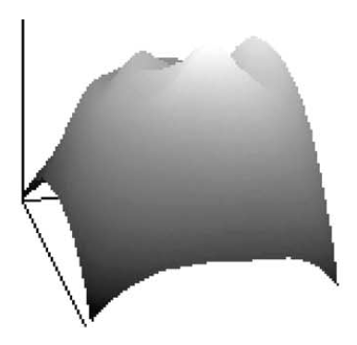
Method
Example potential energy surface
Example force field vectors for an image
Images source : [1]
Notes:
Calculating the force field vectors for each pixel in an image of an area of interest
Calculating the potential energy fields for each pixel to find the overlapping potential energy functions of all the image pixels for that specific pixel location which is repeated for all pixels in the image to generate a potential energy surface

Slide 14
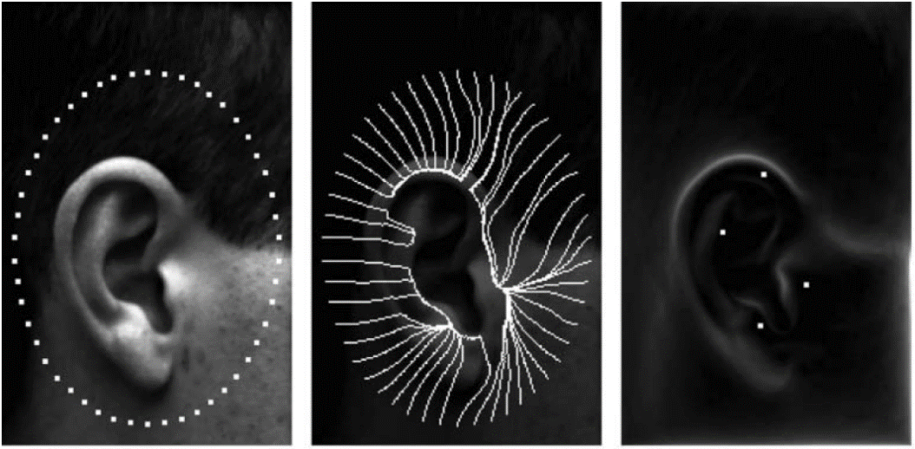
Method
1. Initialisation 2. Force channels 3. Superimposed wells
Images source : [1]
Notes:
Force field –> potential energy surface: comparable to mountain with peaks and ridges, where peaks = potential energy wells (sources) and ridges = energy channels, that lead to the wells (picture 2)
To discover the force field lines: generate an array of unit value mobile test pixels arranged in a closed loop surrounding the ear, which are then solely being ‘pulled’ by the force (gravity) fields of the ear’s pixels vectors so that their trajectory form the field line until they reached an extremum in the potential energy surface: gradient is zero and no further force is exerted = no more movement
Picture 3: superimposed wells over force field magnitude

Slide 15
Method Application
Initialisation and scale invariant
Intensity scale invariant
Affected by localized changes in illumination
All information is conserved by the transform
Descriptors (e.g. wells positions) are unique
Notes:
Show scale invariance, initialisaition invariance follows: It can be shown that the force and energy fields scale by the same factor by which the image was scaled. This results from the fact that larger distance imply weaker forces
O
O
Representation matrices are square and invertible, which was confirmed by test on different sized images
Confirmed by measured averaged normalised distance of the well positions together with the accumulated direction to the position of each well-point from a chosen reference point
Use enough initialisation points to ensure all wells are extracted
For Robustness against noise: Use channels instead of wells positions

Slide 16
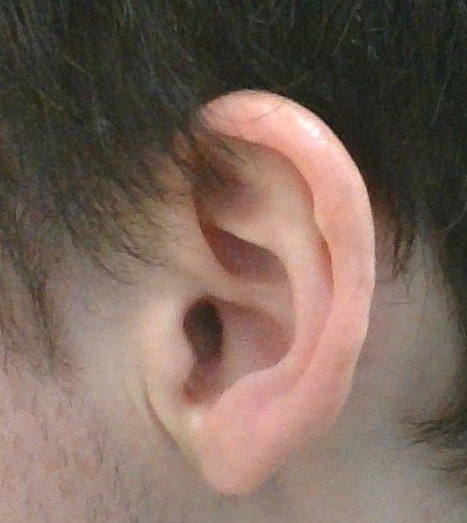
Demonstration

Slide 17
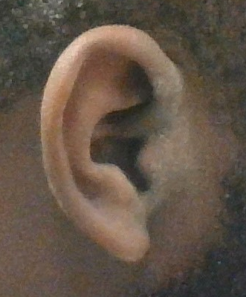
Demonstration

Slide 18
Demonstration
Live Demo
Notes:
- Talk about implementation details, show the code and how it works
imageForceField2
There is a scaling factor which doubles the image
The Force field numbers are transformed into real numbers from complex number vector space
They are rescaled to values between 0 and 255
The generated force field is re-arranged differently and therefore need to be stitched together into an image
This stitching depends on the scale value used
They are then stacked together easily using numpy helper functions
The trick to making it work is to resize the image to smaller values roughly around (300,200)
300 x 200 = 60000 pixels which gets scaled x2 => 120,000 , which is a lot even using the fourier transform on a simple machine like this
Imagine a larger image of around (500,500) => 500,000 pixels
For real time streaming, as shown in the code `stream`, its best a small image size is used (250,150)

Slide 19
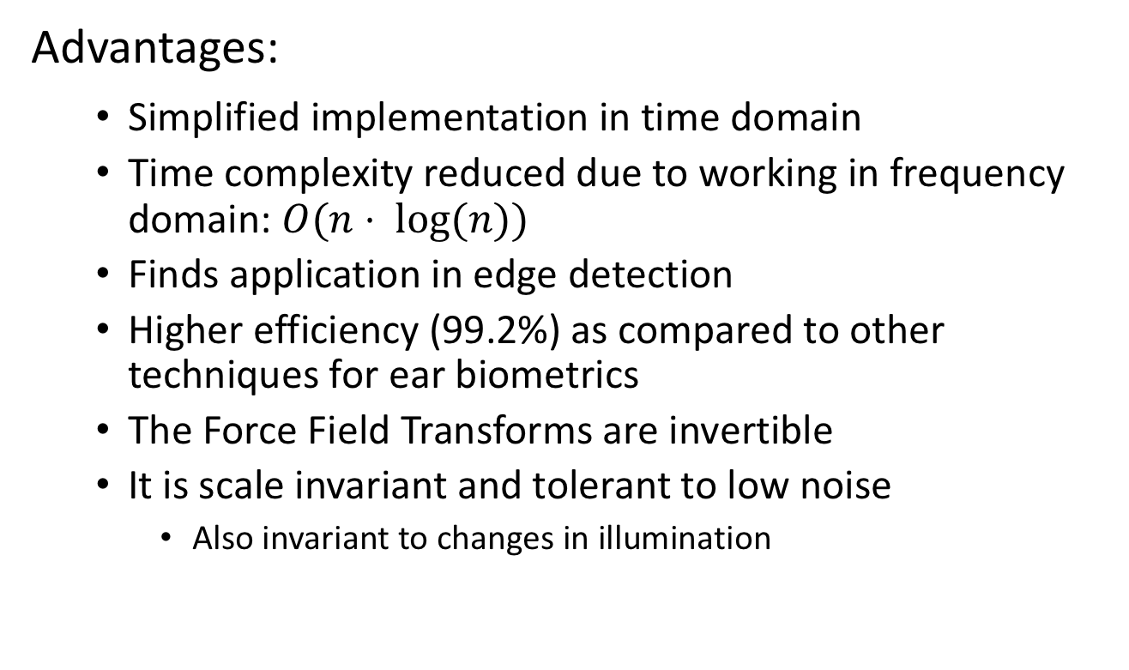
Result
Advantages:
Simplified implementation in time domain
Time complexity reduced due to working in frequency domain: $O(n⋅ log⁡(n))$
Finds application in edge detection
Higher efficiency (99.2%) as compared to other techniques for ear biometrics
The Force Field Transforms are invertible
It is scale invariant and tolerant to low noise
Also invariant to changes in illumination
Notes:
1. It takes forever to compute using the brute force approach

Slide 20

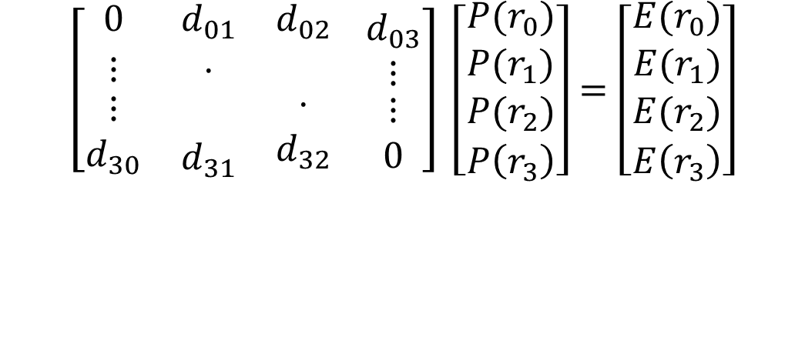
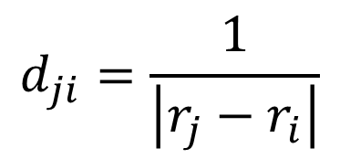



Result
Invertible linear energy transform
$$d_{ji}=\frac{1}{\left|r_{j}−r_{i}\right|}$$
$$DP=E \\ P=D^{−1}E$$
$$\left[\begin{matrix}0 & d_{01} & d_{02} \\ ⋮ & ⋅ & \\ \begin{aligned}⋮ \\ d_{30}\end{aligned} & \begin{aligned} \\ d_{31}\end{aligned} & \begin{aligned}⋅ \\ d_{32}\end{aligned}\end{matrix} \begin{matrix}d_{03} \\ ⋮ \\ \begin{aligned}⋮ \\ 0\end{aligned}\end{matrix}\right] \left[\begin{matrix}P(r_{0}) \\ P(r_{1}) \\ \begin{aligned}P(r_{2}) \\ P\left(r_{3}\right)\end{aligned}\end{matrix}\right]=\left[\begin{matrix}E(r_{0}) \\ E(r_{1}) \\ \begin{aligned}E(r_{2}) \\ E\left(r_{3}\right)\end{aligned}\end{matrix}\right]$$
$$D$$
$$P$$
$$E$$

Slide 21
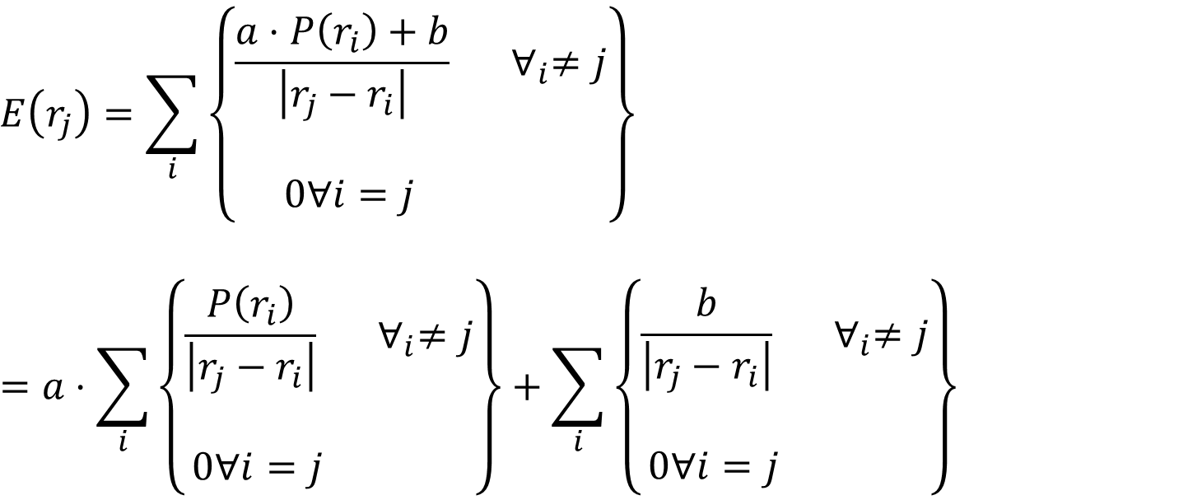
Result
Shape & brightness sensitivity
$$E\left(r_{j}\right)=\sum_{i}{\left\{\begin{aligned}\frac{a⋅P\left(r_{i}\right)+b}{\begin{aligned}\left|r_{j}−r_{i}\right| \\ \end{aligned}} ∀_{i}≠j \\ 0∀i=j \end{aligned}\right\}}$$
$$=a⋅\sum_{i}{\left\{\begin{aligned}\frac{P\left(r_{i}\right)}{\begin{aligned}\left|r_{j}−r_{i}\right| \\ \end{aligned}} ∀_{i}≠j \\ 0∀i=j \end{aligned}\right\}}+\sum_{i}{\left\{\begin{aligned}\frac{b}{\begin{aligned}\left|r_{j}−r_{i}\right| \\ \end{aligned}} ∀_{i}≠j \\ 0∀i=j \end{aligned}\right\}}$$

Slide 22

Result
Disadvantages:
At times, transform generates only one ‘well’
High computational costs for brute-force method: $O(n²)$
Not widely applicable
Occlusion by hair

Slide 23
Sources
[1] | D.J. Hurley, M.S. Nixon, J.N. Carter, “Force field feature extraction for ear biometrics”, doi: 10.1016/j.cviu.2004.11.001,2004.
[2] | Nixon M.S., Aguado A.S. Feature Extraction and Image Processing for Computer Vision, 3ed., 2012, ISBN: 0123965497, p. 121 - 122

Slide 24
Work distribution
Equal workload for both group members in every part of the project with different focusses for the presentation:
Ganiyu | Implementation of stream feature and work on both approaches for the force field transformation; focused on math for implementation part
Philipp | Worked on both approaches when issues occurred and provided comparisons to other implementations; focused on theory of the approach as a whole

Slide 25

Discussion
Any Questions?

